Slide 1
Rising Rates and housing Impact
Justin Bernier, Ankita Sarkar, Kimberly Sernett

Slide 2
Introduction
Objective:
See if the changes in the federal funds rates and mortgage rates are having an impact on the real estate markets in the Austin area.
Impacts we focused on included housing sale prices, inventory, and whether homes are being sold above or below listing price.

Slide 3
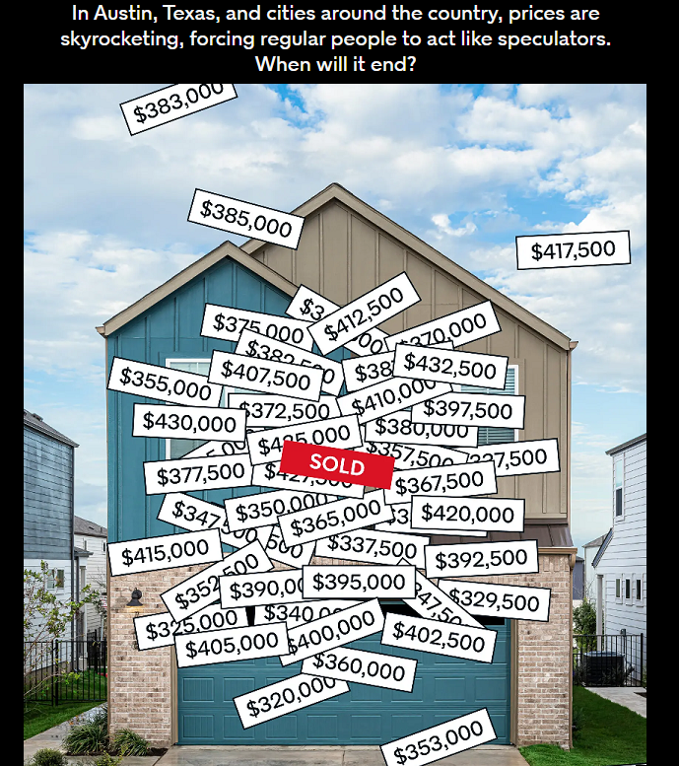
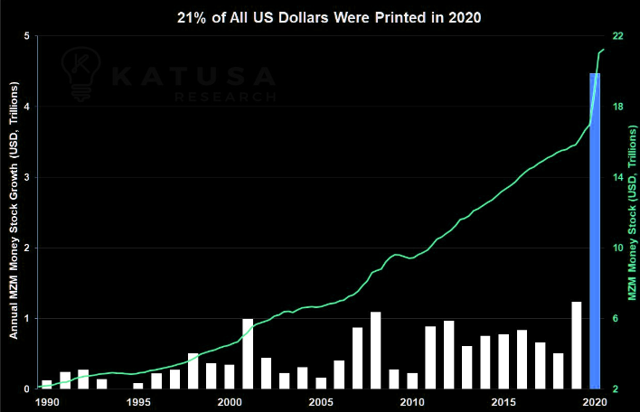
Austin, TX
Known as a hot real estate market
Fed set lending rates to near 0% in 2020
~4 trillion US Dollars printed in reaction to Covid

Slide 4
Hypothesis
Fed rate increases are impacting the Austin real estate market by slowing it down.

Slide 5
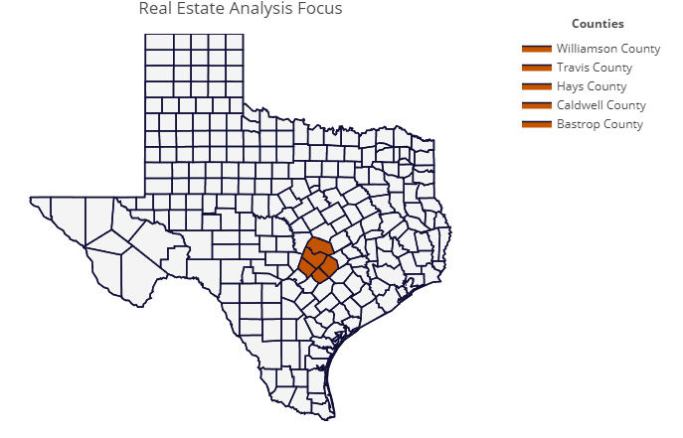
Geographic focus

Slide 6
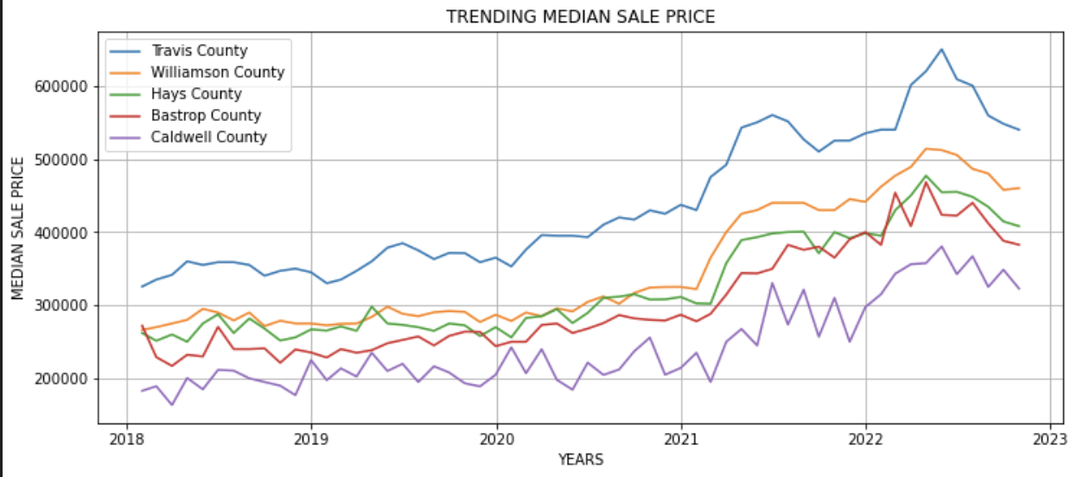
Trending median sale price

Slide 7
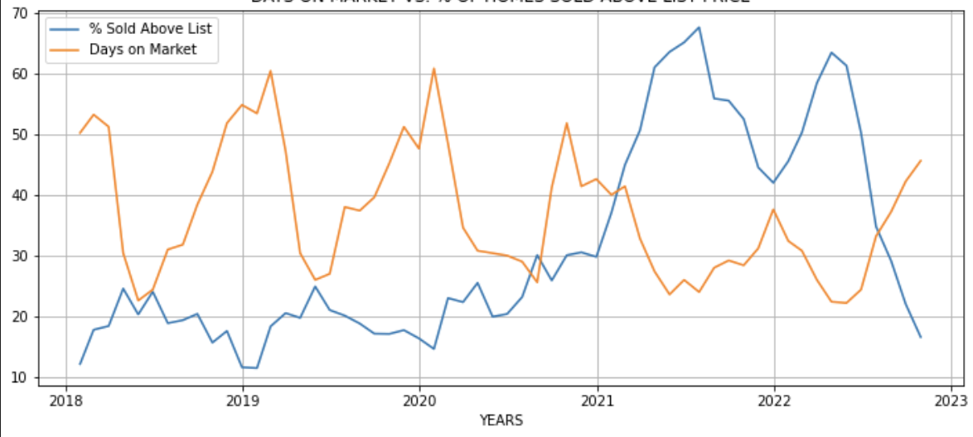
Days on market vs. % of homes sold above list price

Slide 8
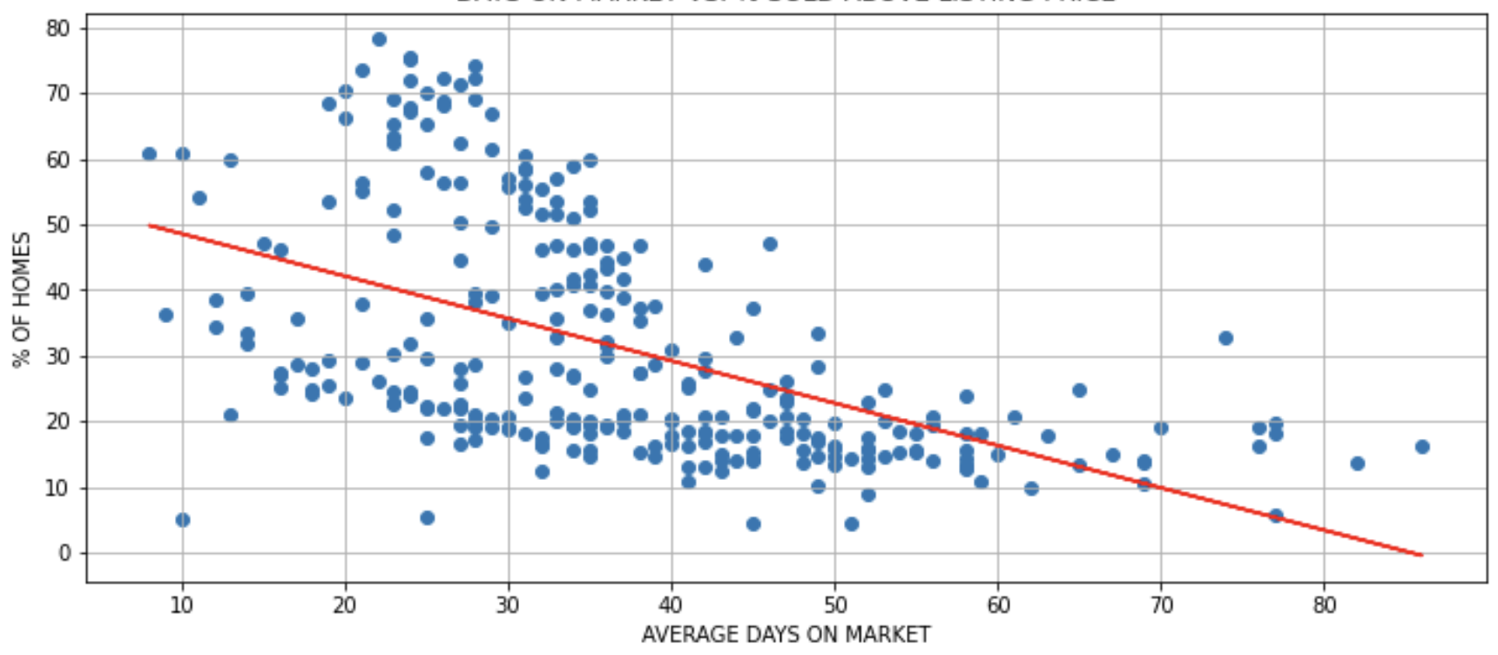
Days on market vs. % sold above listing price

Slide 9
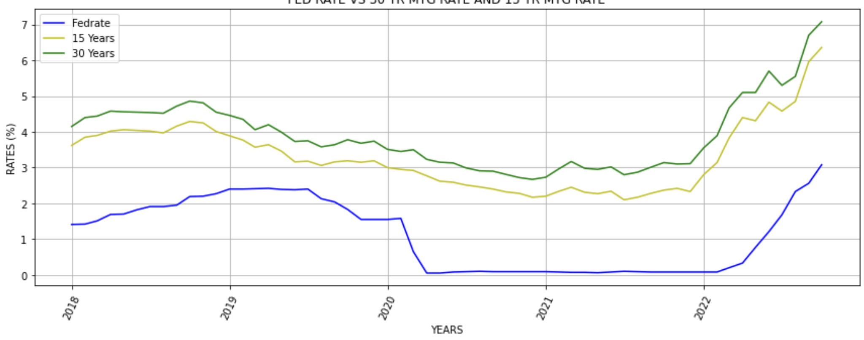
Fed rate vs. 30-year mtg rate and 15-year mtg rate

Slide 10
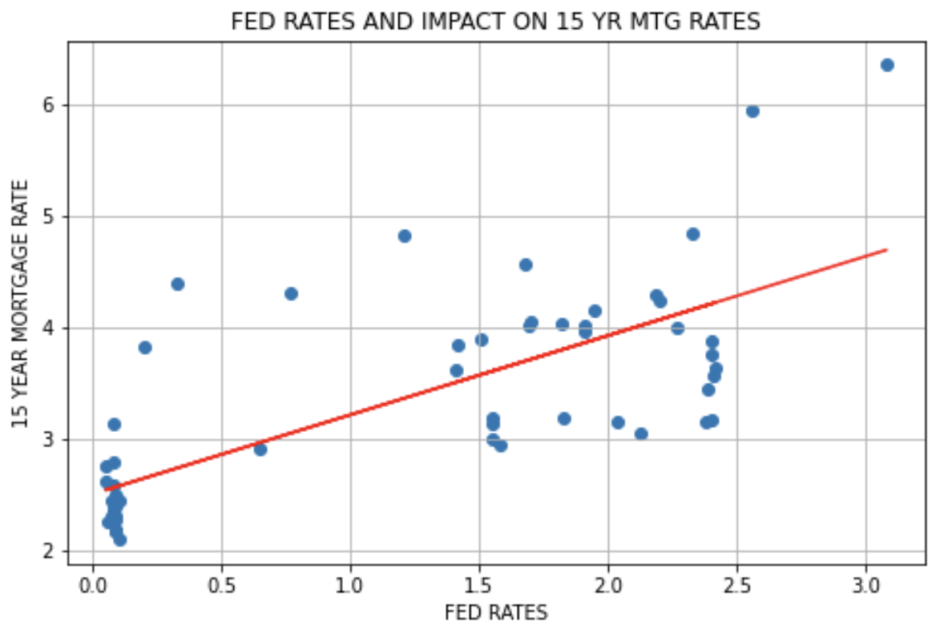
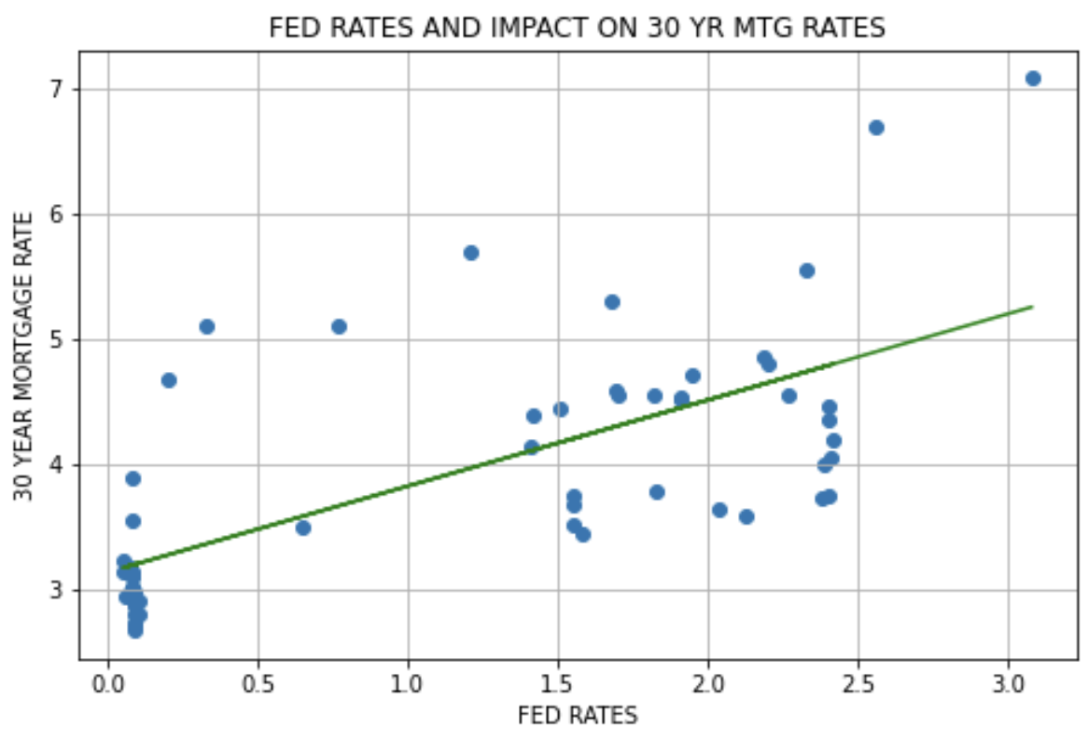

Slide 11
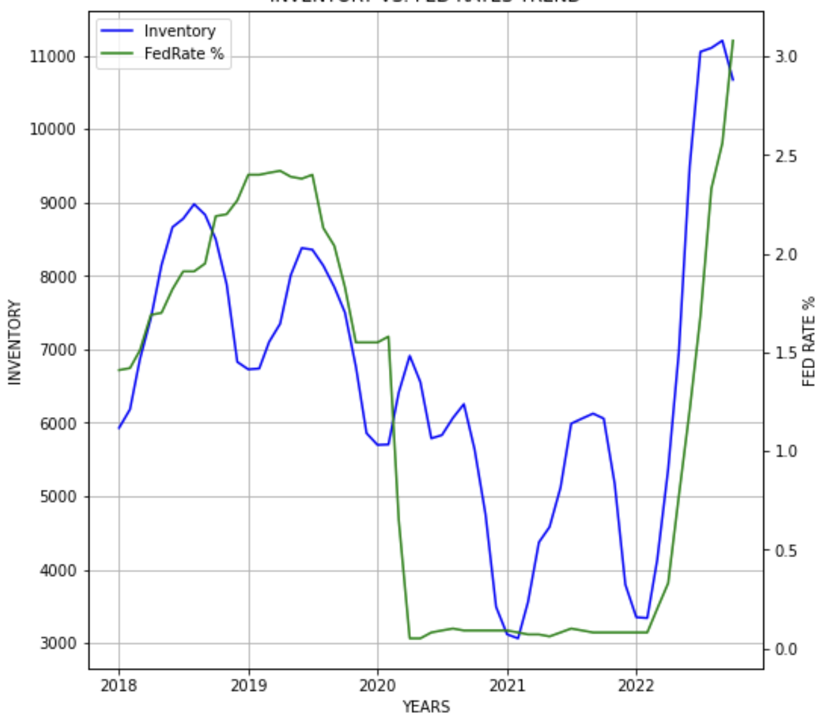
Inventory vs. fed rates trend

Slide 12
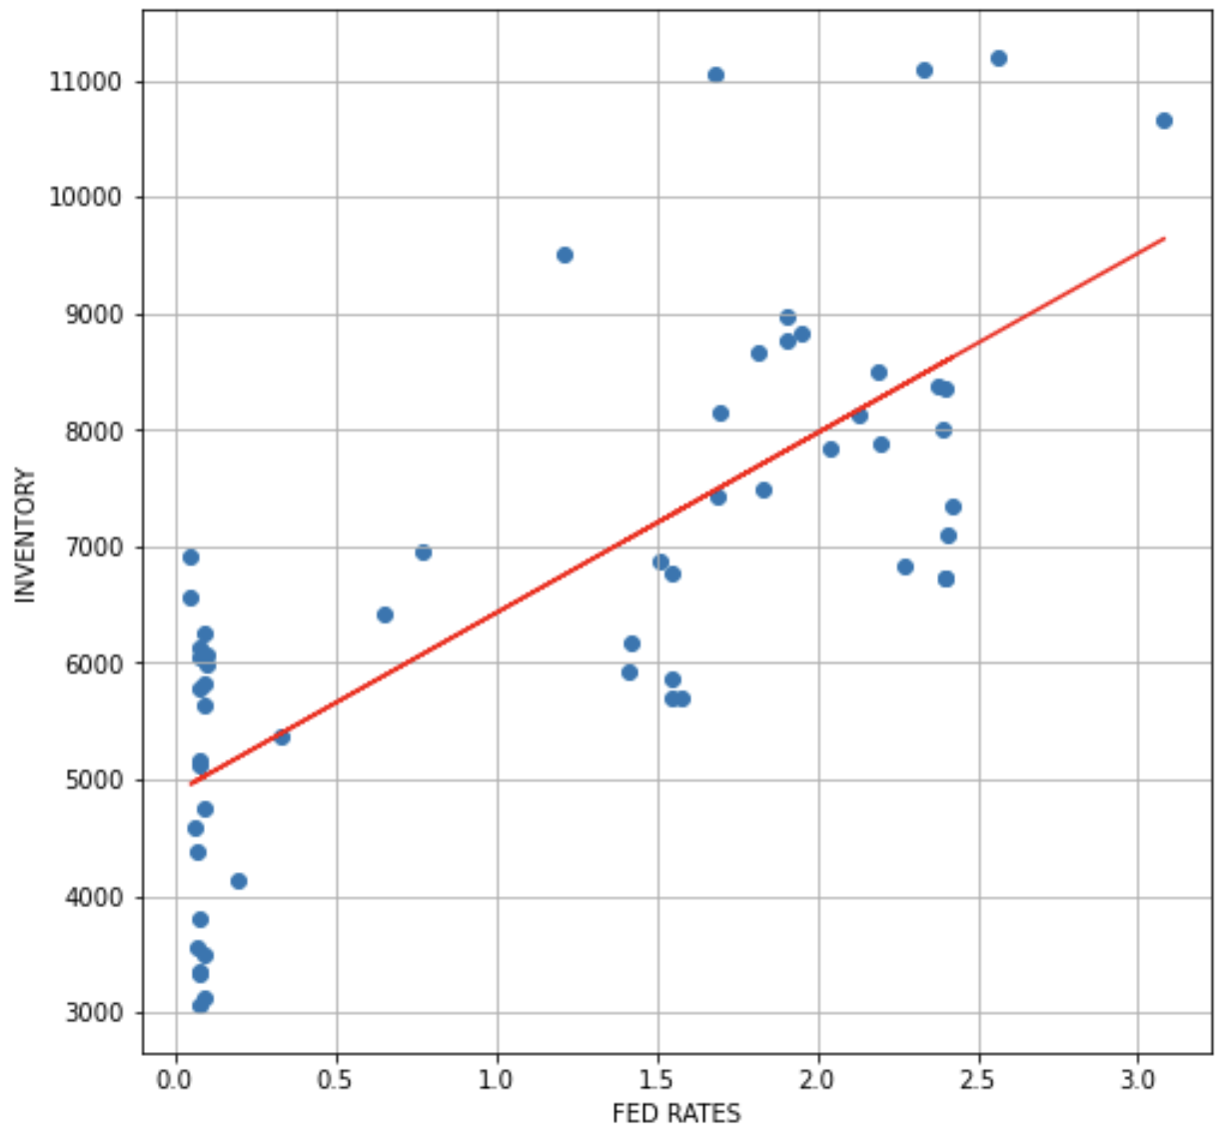
Inventory vs. fed rates correlation

Slide 13
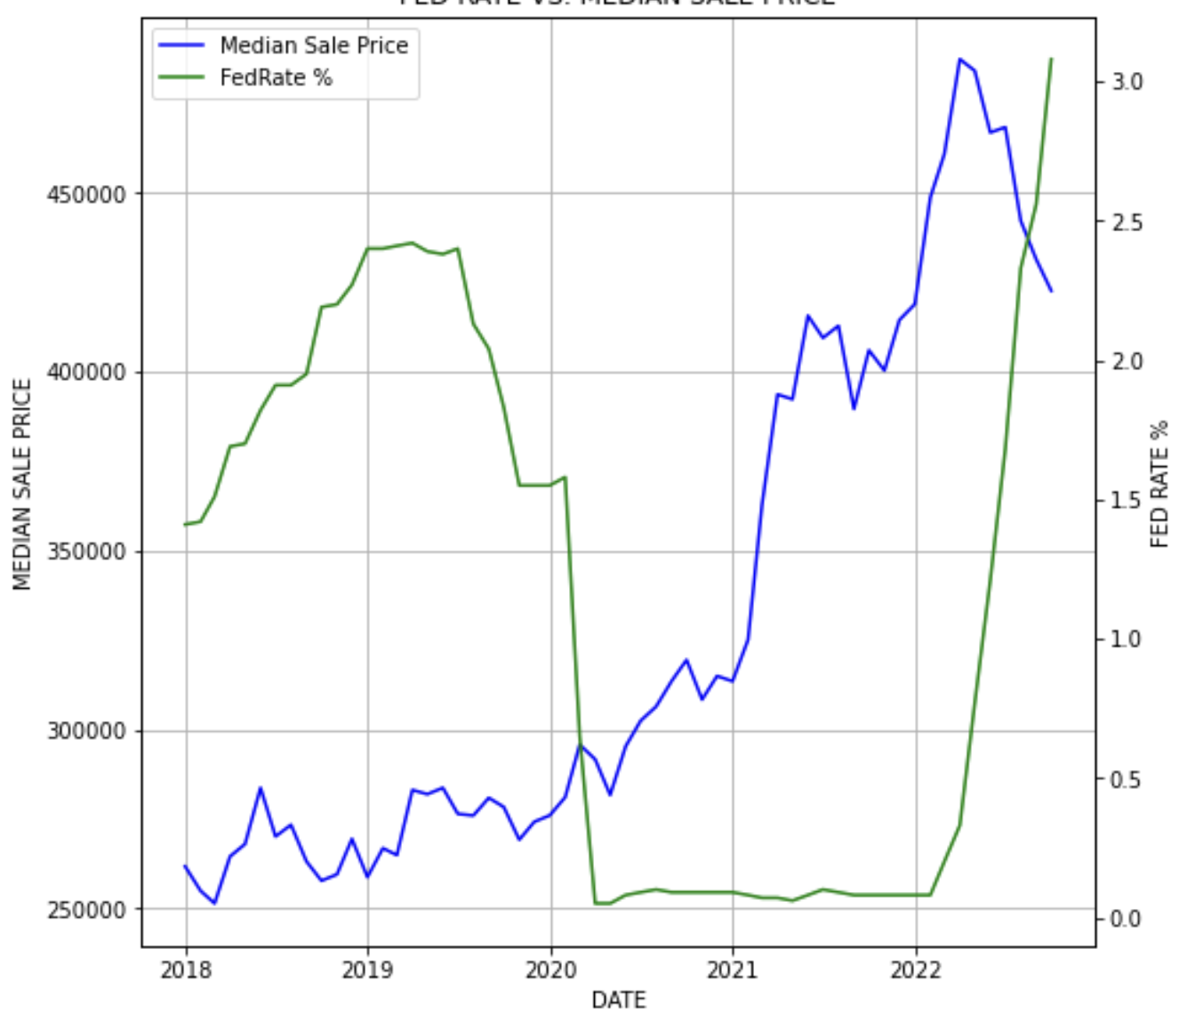
Fed rate vs. median sale price

Slide 14
SUMMARY
Summary 1
Summary 2
Summary 3

Slide 15
Thank you!

